Slide 1
Exam Slides
Cleanroom Fabrication – Joel von Rotz

Slide 2
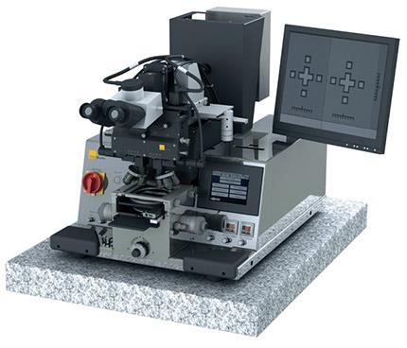
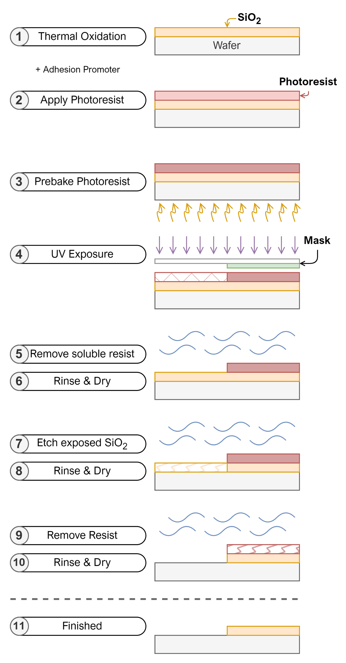
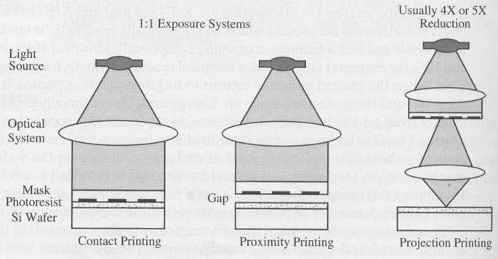
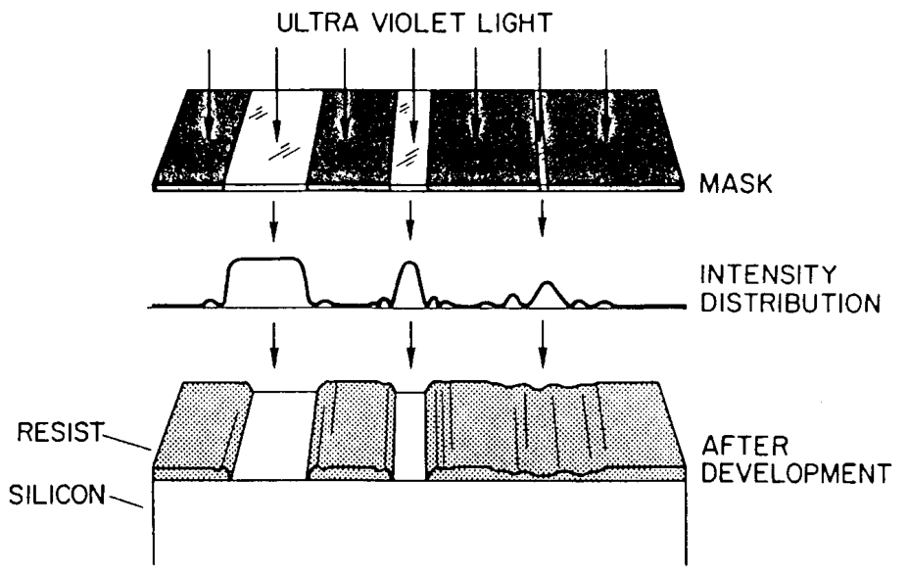
Photolithography
Lithography
Photolithography
Photoresist
Process
Mask Aligner
Exposure Systems
Practical Limit: ~0.7-1μm
Practical Limit: <0.1μm
Notes:
Lithography
Types of Lithography: Photolithography ; Electron beam lithography (EBL) ; Nanoimprint lithography (NIL)
What is Lithography? Used to create a pattern on the surface of a substrate (such as a silicon wafer)
Photolithography
Basic Photolithography Process
CAD System -> draw layout, simulation, design rule checking
Mask Making -> Using electron gun to engrave the designed pattern into the mask or onto the quartz glass
Wafer Expose -> the photolithography step of applying the mask to the wafer
Steps
UV Light
To draw the patterns from the mask onto the wafer, a good enough light source is required. Nowadays UV light is used to to it's smaller wavelength, which allows for better pattern resolutions on the wafer.
Mercury high-pressure arc lamp
Diffraction
As light bends around edges, it diffracts from its "ideal" path, also called diffraction.
Using masks, the light diffracts more, the bigger the gap is. By reducing (for example with contact printing), the diffraction can be mitigated.
1:1 Printing
Under 1:1 printing is a exposure system, which does not use magnifying glasses to scale the mask somehow.
Exposure Systems
Contact: mask directly placed on top wafer (limit: ~0.7-1μm)
Proximity: between mask and wafer is a gap (bigger gap, more diffraction)
Projection: Mask scaled down to final size (limit: <0.1μm)
Tools
Mask Aligner
The Hg (mercury) lamp emits an unevenly spread UV light -> Using mirrors to correct the light
To align a mask with a previously etched wafer, it needs to align with alignment mark
Photoresist (RESIN)
Positive R: curved edges, masked area is not soluble
Negative R: overhang edges, exposed area is soluble
Image Reversal (first exposed area is soluble!
Resist Adhesion
To make the wafer more suitable for PR, adhesion promoter is applied onto the wafer using a HMDS
HMDS - Hexamethyldisilane -> Applied in vapour form in vacuum chamber
E-Beam Litho: Direct Writing ; electron optics (coils) ; high resolution (<100mm) ; low throughput
Nanoimprint Lithography: Thermal NIL ; UV NIL

Slide 3
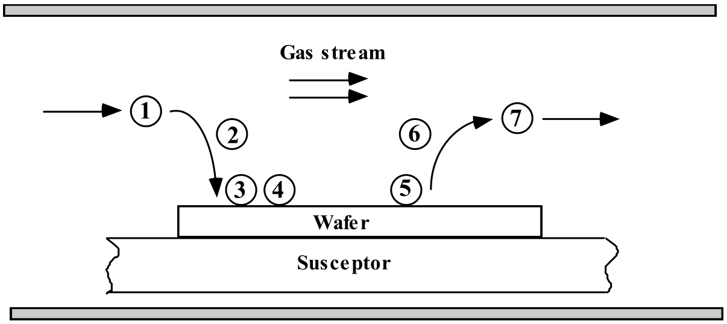
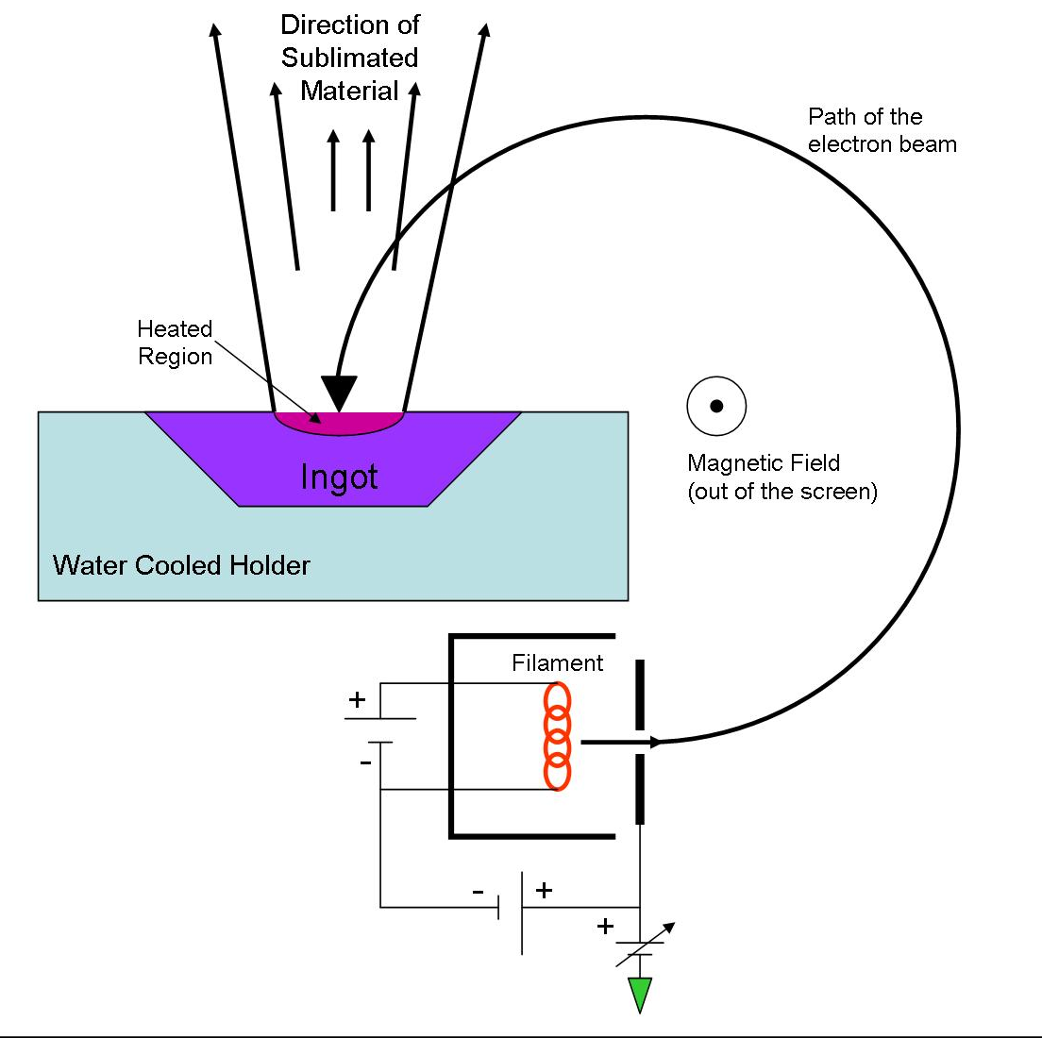
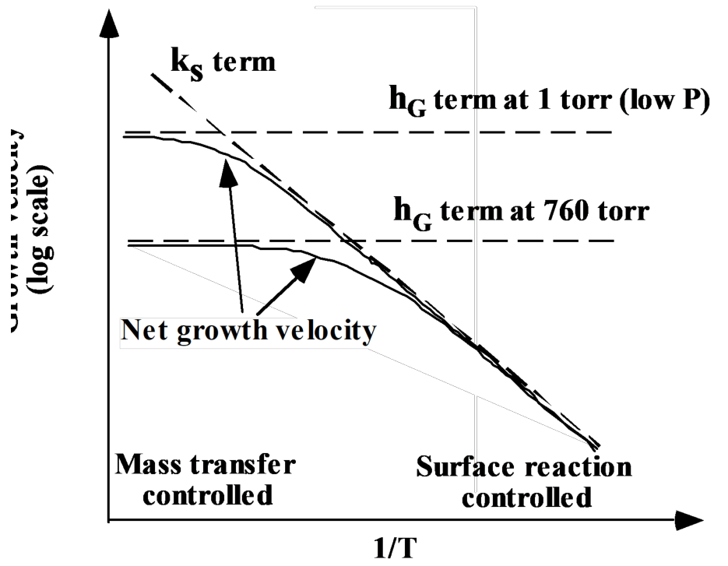
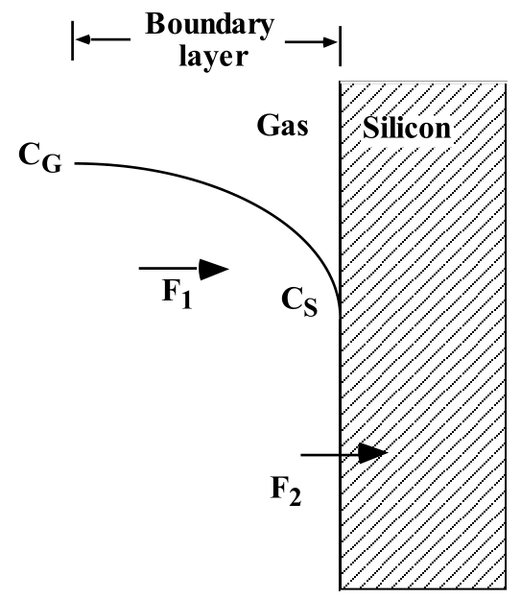
Deposition of thin films
PVD
Vacuum Chamber
Difference between CVD & PVD
CVD: LPCVD
PVD: E-Beam Evaporation
Wafer
CVD
Microbalance
Notes:
CVD
Transport of reactants to the deposition region.
Transport of reactants from the main gas stream through the boundary layer to the wafer surface.
Adsorption of reactants on the wafer surface.
Surface reactions, including: chemical decomposition or reaction, surface migration to attachment sites (kinks and ledges); site incorporation; and other surface reactions (emission and redeposition for example)
Desorption of byproducts.
Transport of byproducts through boundary layer.
Transport of byproducts away from the deposition region.
APCVD: Atmospheric Pressure CVD + high temperatures
The above system contains RF induction coils to control the temperature of the chamber.
The wafers are placed on top a graphite susceptor, which is slightly angled so all wafers are exposed.
Gas inserted into chamber, reaction happens, gas goes out through vent.
LPCVD: Low Pressure CVD + high temperature
Reduced pressures reduces unwanted gas-phase reactions and improve film uniformity across the wafer.
Plasma Enhanced CVD (PECVD): low temperature vacuum thin film deposition process with a very strong position in the semiconductor industry
Plasma consists of electrons, ionized molecules, neutral molecules, neutral and ionized fragments of broken-up molecules, excited molecules and free radicals.
Free radicals are electrically neutral species that have incomplete bonding and are extremely reactive. (e.g. SiO, SiH3, F)
The net result from the fragmentation, the free radicals, and the ion bombardment is that the surface processes and deposition occur at much lower temperatures than in non-plasma systems.
Epitaxial Growth
CVD Modelling
$F_{1}$: Mass Transfer Flux, Step 2
$F_{2}$: Surface Reaction Flux, Steps 3-5
The growth rate can be adjusted via pressure. Lowering the pressure reduces the gas-density and therefore increases the deposition rate.
PVD
2 general types: Evaporation and Sputtering
Evaporation
Compared to CVD, this does not use any gases and operates in vaccuum.
Thickness Uniformity
As the wafer is not curved, there will be slightly different thicknesses on the wafer, due different evaporation rates. If uniformity is important, increase the substrate distance, which unfortunately reduces the rate () and might require a bigger chamber.
Sidewall Coverage
Measuring the Deposition Rate during Deposition
A quartz crystal microbalance (quartz crystal between two electrodes, oscillation frequency depends on the mass) can be used to measure the thickness of the deposited material on the wafer.
E-Beam Evaporation: Electron Gun → very precise, but pricey
Thermal Evaporation: Resistive Heater → can cause contamination from crucible
Sputtering
Sputtering uses an electric field and a noble gas, such as argon, to take material from the target plate or cathode to the wafers, which are on top the anode.
DC Sputtering
DC Sputtering allows only conductive material to be deposited!
Cathode negative, anode positive
Neutral Argon ionized via forceful collision
Charged Argon moves towards anode, bringing vaporized target with
Magnetron traps electrons over negative cathode/target → not free to bombard the substrate, increasing faster deposition
Voltage Distribution
RF Sputtering
RF Sputtering can deposit most materials (conductive and non-conductive
Cathode and Anode are RF charged
Over time, positive ions are accumulated on target surface
Enough positive charge, complete secession happens → discharged for coating
Adv. RF diffuses entire chamber → charged is “cleaned” off
Disadv. does not acquire great charge buildup due to being discharged each half cycle and becoming insulated.
Voltage Distribution

Slide 4
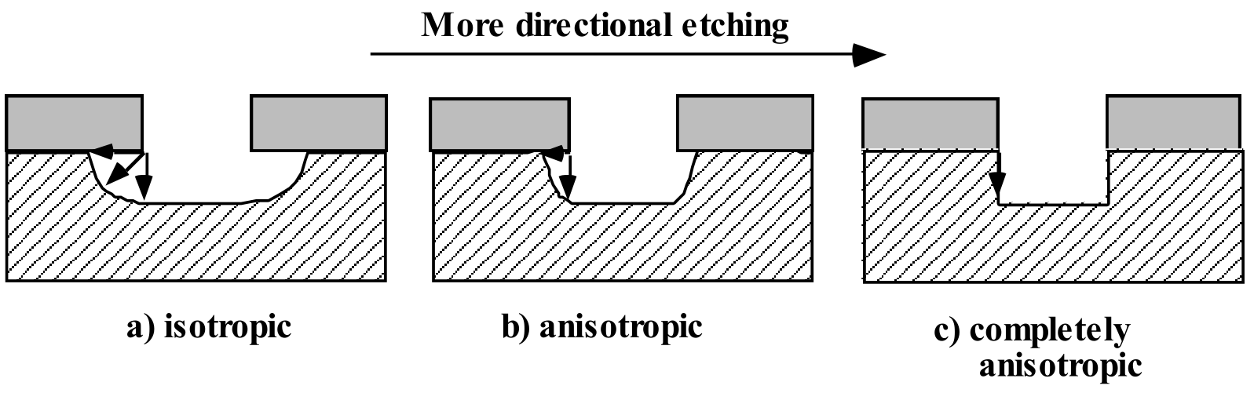
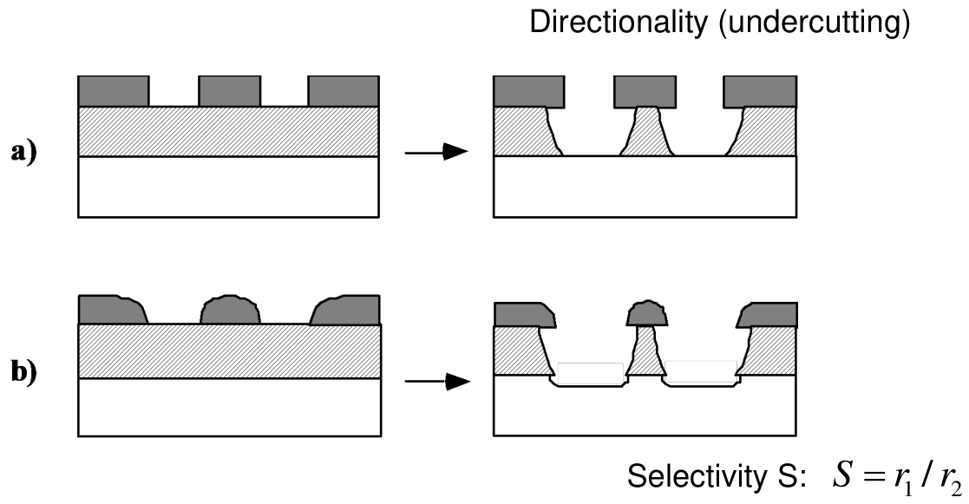
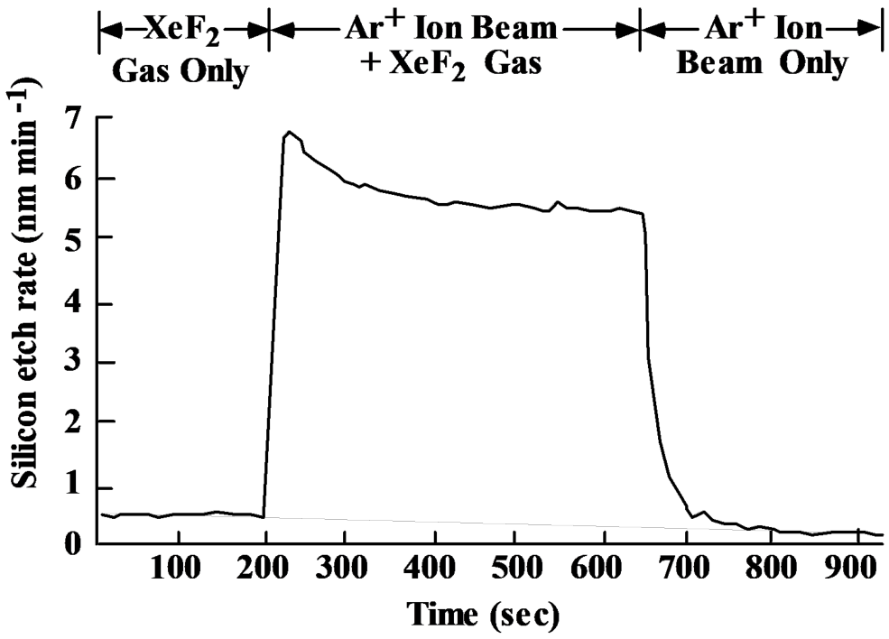
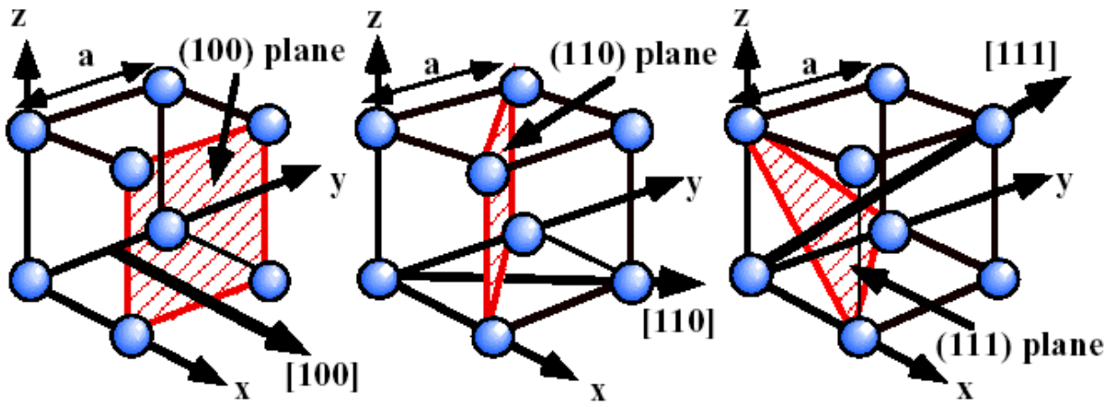

Etching
What is Etching?
Wet & Dry Etching
Dry & Wet Etching
Selectivity
Etch Anisotropy
Dry Etching
Plasma Etch - Physical
Surface Atom Density: $\{111\}>\{100\}>\{110\}$
Etching Rate: $R\left(100\right)>100×R(111)$
Notes:
Etching: is process of removing material through various methods such as dry and wet etching.
Wet Etching
Chemical Process
Wafers are immersed in liquid etchant solution and dried afterwards.
Dry Etching
Physical & Chemical Process
Wafers are exposed to gas-phase etchants in the form of a plasma (plasma etching)
Wet vs. Dry Etching
Selectivity: to compare the etch rate differences between two materials → relative characteristic.
Wet Etching?
Etch Rate Table
The etch rate table provides an overview on etch rates of different etchants on different materials.
Noteworthy Etchants: - Silicon Etchant (126 HNO₃ ; 60 H₂O ; 5 NH₄F) -> etches silicon and not photoresist - KOH (1 KOH, 2 H₂O by weight) -> Crystallographic Etching <100> Silicon - Acetone (C₃H₆O) -> used to remove Photoresist
Crystal Directions and Planes
Equivalent directions . : , , , , …
Specific plane . The specific direction is normal to .
Equivalent planes
Crystallographic Etching
As silicon is a crystalline material, etching rate on more densely packed surfaces are lower than on that of loosely packed surfaces.
Different Etch Rates
Atoms within the and faces possess two dangling bonds, two bonds into the crystal (less binding energies)
Atoms within the faces possess only a single dangling bonds (larger binding energies)
Etch Anisotropy
Different plane directions provide vastly different etch rates (100 vs 111), therefore a pyramidic shape gets etched with a bit of isotropic etching.
Dry Etching
Physical & Chemical Etching in a Plasma
Chemical etching (radical species): isotropic, selective
Physical etching (ions): anisotropic, less selective
Ion-enhanced etching: anisotropic, selective
Chemical Etching
Physical Etching
Ion Enhanced Etching →
The chemical and physical components can act in a synergistic manner
Etch profiles can be very anisotopic, and selectivity can be good.
Plasma Etching Types

Slide 5
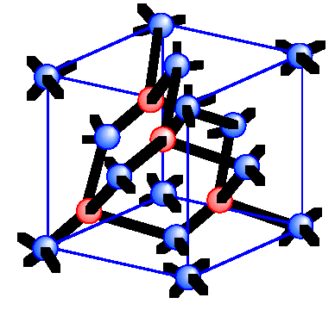
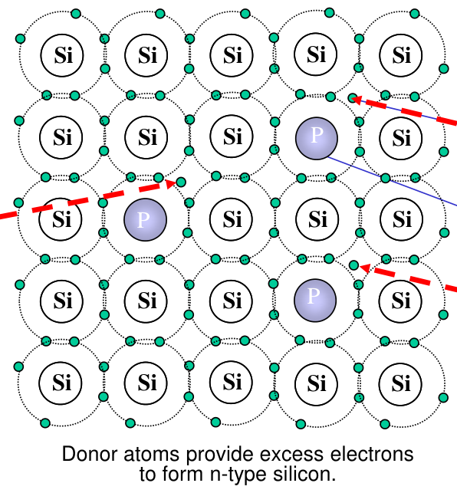
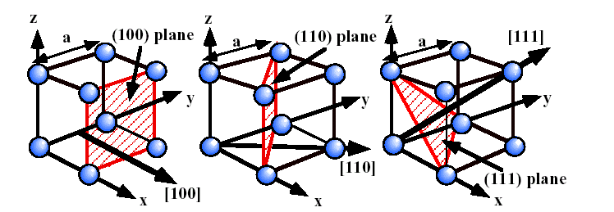
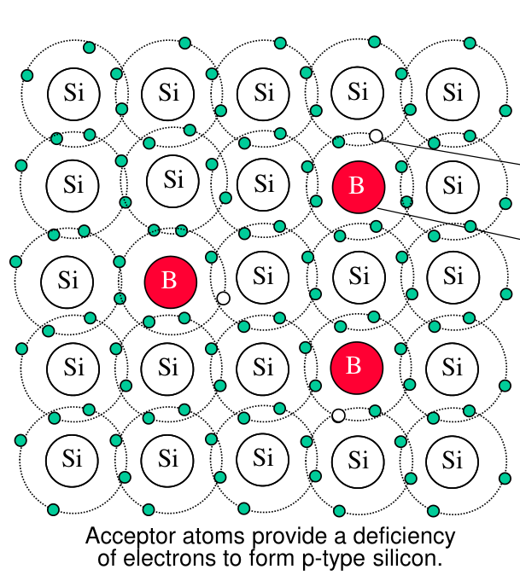
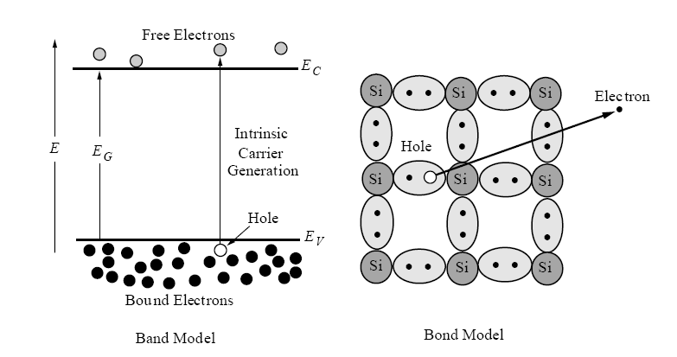
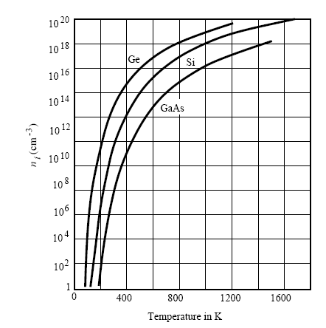
Silicon - Si
What is Silicon?
Crystal Structure
Electrical Properties
Bandgap
Doping
Notes:
What is Silicon?
Si-Atom: 2 + 8 + 4 = 14 Atoms
4 Valence Electrons -> 4 chemical bonds possibile
Carbon structure allows for wafers with specific "cut directions"
Why Silicon? – Abundant element (~26%) ; Simple Purification ; Good crystal quality
What can it be used for?
Integrated Circuits -> Computers, Microcontrollers, logic gates, amplifiers, etc.
Micro-ElectroMechanical Systems
Crystal Structures: cubic (1 atom per unit cell), BCC (2), FCC (4)
Crystal Directions and Planes: The directions are noted in the Miller Index form
Silicon Unit Cell: 2 FCC Sub Cells ; Shift: 1/4 body diagonal
Electrical Properties
Bandgap (Electron Energy ; Conduction & Valence Band)
Conductor (Overlap) ; Insulator (Separation) ; Semiconduction (smaller gap + can be changed)
thermal excitations responsible for electron transport from valence to conduction. If too cold ($0K$), transport not possible
Intrinsic carrier concentration concentration of the ‘free’ carriers for transport.
Doping (intentional introduction of impurity to alter property)
The resistivity of a semiconductor material generally decreases as the doping concentration increases.
p-doped uses Boron (introduces holes)
n-doped uses Phosphorus (introducing excess electrons)

Slide 6
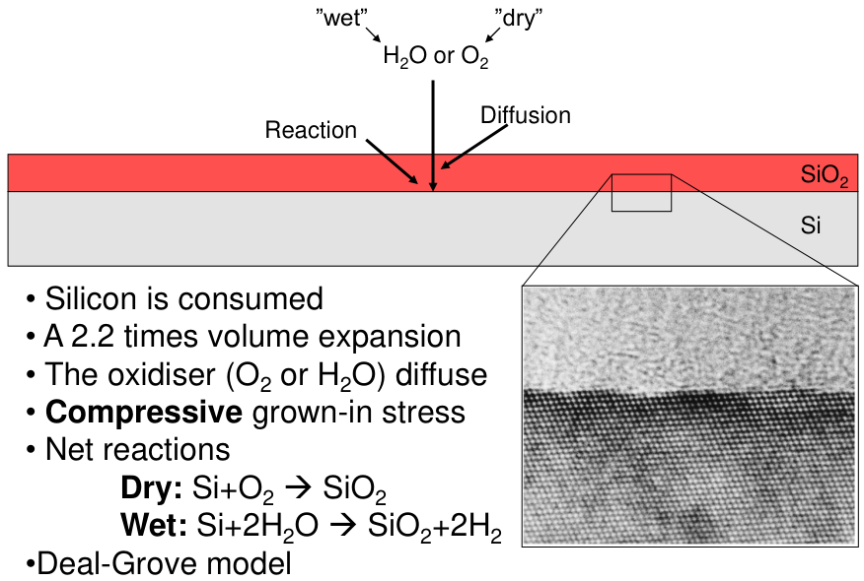
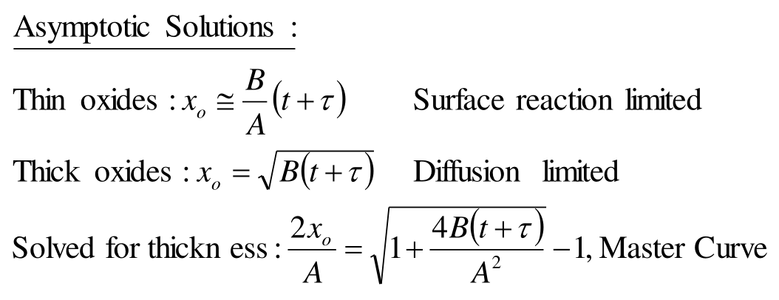
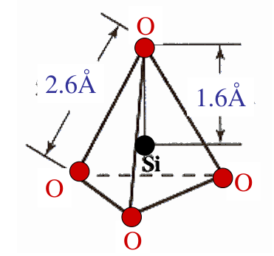
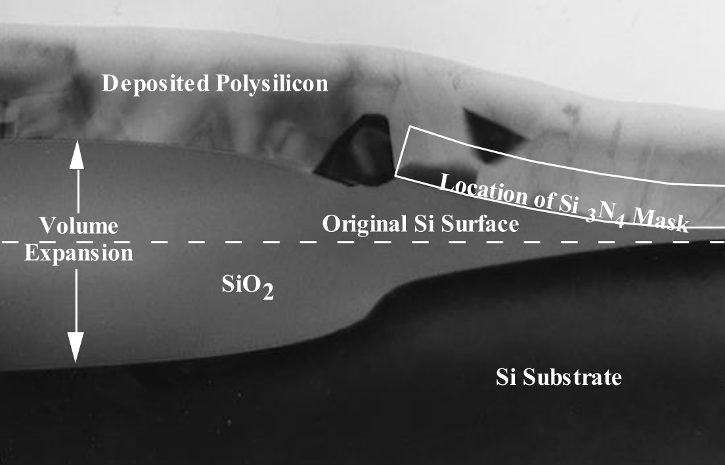
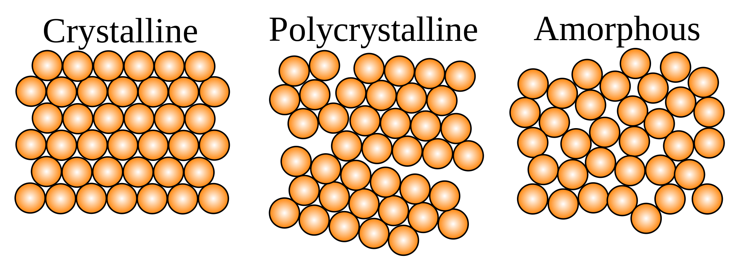
Thermal Oxidation of Silicon
What is Thermal Oxidation?
Wet & Dry Oxidation
Silicon Dioxide
Deal-Grove Model
Thermal Oxide
SiO₂
Si
Notes:
What is the Thermal Oxidation used for?
By heating up the wafer (to 800°C-1200°C) and supplying O₂ or H₂O creates a SiO₂ layer on the Si layer
Dry: Si + O₂ -> SiO₂
Wet: Si + H₂O -> SiO₂ + 2 H₂
Volume Expansion Factor: 2.2
consumes Silicon
Deal-Grove Model shows the concentration amount depending on the thickness of the material. Si is zero, due to turning into SiO₂. The thicker SiO₂ gets, less concentration can reach Si.
The flux rates (analogy current in series resistor circuit) are the same
What is the oxidation master curve?
What needs to be considered when using Thermal Oxidation?
Volume Expansion
As with any other physical material, it expands with increasing temperature. It expands by a factor of 2.2 of it's volume. Meaning a silicon cube expands to .
How does Thermal Oxidation work?
To etch structures reliably into Si-Wafers, they are treated in a oxidation furnace.
Wafer are loaded into boat (with dummy wafers outside for better temperature isolation for the other wafers)
Wafers get heated up
Treatment gas is inserted (such as O₂, H₂O) and diffuses with the silicon and reacts, resulting into SiO₂
How is the thickness of SiO₂ measured?
Profilometer / AFM
An Atomic Force Microscope uses a tiny needle, laser and photodiode to detect topological changes on the sample.
Optical measurements such as Interferometry, Ellipsometry, Visual inspection
An Ellipsometer measures the phase shift of a laser shun into the wafer. Two reflections will occur and are timely differently measured (phase shift).
Silicon Dioxide: A product of thermal oxidation
Acts as a insulator
Is used for example for oxide layer in a MOSFET.
While silicon has a diamond structure, thermally grown silicon dioxide is amorphous (meaning no crystalline structure)
Through the thermal procedure, the structure is as mentioned before amorphous, meaning no rigid crystalline structure. While it is a faster oxidation, it leads to no nice structures

